Slide 1
Machine-independent Optimizations

Slide 2
Code Optimization
High-level language constructs can introduce substantial run-time overhead if naively each construct is independently translated into machine code
Code optimization or code improvement
Elimination of unnecessary instructions in object code
Replacement of one sequence of instructions by a faster sequence of instructions

Slide 3
Code Optimization
Local Optimization
Code improvement within a basic block
Covered in chapter 8
Global Optimization
Code improvement across basic blocks
Focus of this chapter

Slide 4
Global Optimizations
Most global optimizations are based on data-flow analysis (DFA)
DFA are algorithms that gather information about a program
For each instruction in program, specifies some property that must hold every time that instruction is executed
Example:
Constant-propagation analysis: checks if for each point in the program and for each variable used by the program, whether the variable has a unique constant value at that point
Liveliness analysis: checks for each point in the program, whether the value hold by a particular variable at that point is sure to be overwritten before it is read

Slide 5
Principle Sources of Optimization
Compiler must preserve the semantics of the original program
A compiler cannot understand enough about a program to replace with an efficient algorithm!
A compiler knows only how to apply relatively low-level semantic transformations such that performing the same operation on the same values yields the same result.
Examples -
Use algebraic identities such as replacing i+0 with i
Remove redundant operations and codes

Slide 6
Causes of Redundancy
There are many redundant operations in a typical program.
Sometime redundancies are introduced at the source level by the programmer for convenience
- Cut & paste
More often the redundancy is a side effect of writing code in high level language such as an array access, A[i][j]
- During compilation, such high-level data-structure accesses expands into a number of low-level arithmetic operations, such as the computation of the location of the (i, j)th element of a matrix A.

Slide 7
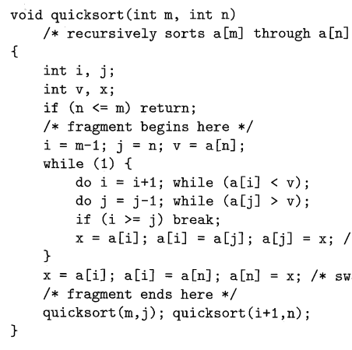
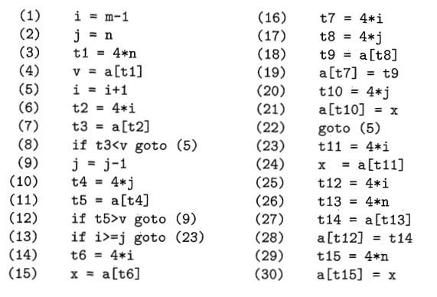
Example
Basic Block
Quick Sort(C)
Quick Sort(TAC)

Slide 8





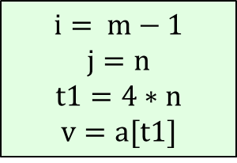






Example
Quick Sort(C)
Quick Sort(Flow Graph)
$$B4$$
$$i= m−1$$
$$j=n$$
$$t1=4∗n$$
$$v=a[t1]$$
$$B1$$
$$if i≥j goto B6$$
$$B5$$
$$B6$$
$$t6=4∗i$$
$$x=a[t6]$$
$$t7=4∗i$$
$$t8=4∗j$$
$$t9=a\left[t8\right]$$
$$a[t7]=t9$$
$$t10=4∗j$$
$$a[t10]=x$$
$$gotoB2$$
$$t11=4∗i$$
$$x=a\left[t11\right]$$
$$t12=4∗i$$
$$t13=4∗n$$
$$t14=a[t13]$$
$$a[t12]=t14$$
$$t15=4∗n$$
$$a[t15]=x$$
$$i=i+1$$
$$t2=4∗i$$
$$t3=a[t2]$$
$$if t3<v goto B2$$
$$B2$$
$$j=j−1$$
$$t4=4∗j$$
$$t5=a[t4]$$
$$if t5>v goto B3$$
$$B3$$

Slide 9
Semantic-Preserving Transformations
Improve code preserving its semantics
Common Examples:
Common subexpression elimination
Copy propagation
Constant folding
Dead-code elimination
Code motion
Induction variables and reduction in strength

Slide 10
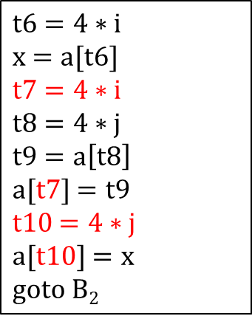


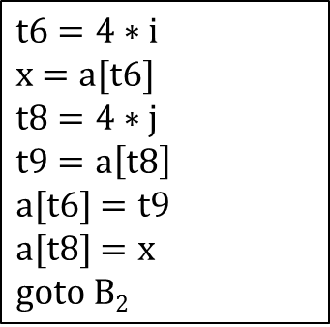
Common-Subexpression Elimination
Local Common Subexpressions Elimination
$$t6=4∗i$$
$$x=a[t6]$$
$$t7=4∗i$$
$$t8=4∗j$$
$$t9=a\left[t8\right]$$
$$a[t7]=t9$$
$$t10=4∗j$$
$$a[t10]=x$$
$$gotoB2$$
$$t6=4∗i$$
$$x=a[t6]$$
$$t8=4∗j$$
$$t9=a\left[t8\right]$$
$$a[t6]=t9$$
$$a[t8]=x$$
$$gotoB2$$
$$B5$$
$$B5$$
Before
After

Slide 11



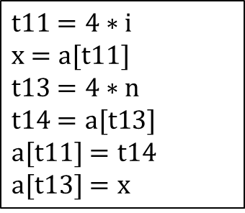

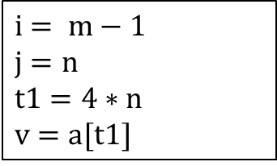






Global Common Subexpressions
$$i= m−1$$
$$j=n$$
$$t1=4∗n$$
$$v=a[t1]$$
$$B1$$
$$if i≥j goto B6$$
$$B4$$
$$t6=4∗i$$
$$x=a[t6]$$
$$t8=4∗j$$
$$t9=a\left[t8\right]$$
$$a[t6]=t9$$
$$a[t8]=x$$
$$gotoB2$$
$$B5$$
$$t11=4∗i$$
$$x=a[t11]$$
$$t13=4∗n$$
$$t14=a[t13]$$
$$a[t11]=t14$$
$$a[t13]=x$$
$$B6$$
$$i=i+1$$
$$t2=4∗i$$
$$t3=a[t2]$$
$$if t3<v goto B2$$
$$B2$$
$$j=j−1$$
$$t4=4∗j$$
$$t5=a[t4]$$
$$if t5>v goto B3$$
$$B3$$

Slide 12


Global Common Subexpressions
i and t2 do not change when block B5 starts to execute
$$i= m−1$$
$$j=n$$
$$t1=4∗n$$
$$v=a[t1]$$
$$B1$$
$$if i≥j goto B6$$
$$B4$$
$$t6=4∗i$$
$$x=a[t6]$$
$$t8=4∗j$$
$$t9=a\left[t8\right]$$
$$a[t6]=t9$$
$$a[t8]=x$$
$$gotoB2$$
$$B5$$
$$t11=4∗i$$
$$x=a[t11]$$
$$t13=4∗n$$
$$t14=a[t13]$$
$$a[t11]=t14$$
$$a[t13]=x$$
$$B6$$
$$i=i+1$$
$$t2=4∗i$$
$$t3=a[t2]$$
$$if t3<v goto B2$$
$$B2$$
$$j=j−1$$
$$t4=4∗j$$
$$t5=a[t4]$$
$$if t5>v goto B3$$
$$B3$$

Slide 13
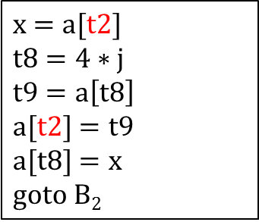
Global Common Subexpressions
No need to calculate t6 and t6 is replaced with t2
$$i= m−1$$
$$j=n$$
$$t1=4∗n$$
$$v=a[t1]$$
$$B1$$
$$if i≥j goto B6$$
$$B4$$
$$x=a[t2]$$
$$t8=4∗j$$
$$t9=a\left[t8\right]$$
$$a[t2]=t9$$
$$a[t8]=x$$
$$gotoB2$$
$$B5$$
$$t11=4∗i$$
$$x=a[t11]$$
$$t13=4∗n$$
$$t14=a[t13]$$
$$a[t11]=t14$$
$$a[t13]=x$$
$$B6$$
$$i=i+1$$
$$t2=4∗i$$
$$t3=a[t2]$$
$$if t3<v goto B2$$
$$B2$$
$$j=j−1$$
$$t4=4∗j$$
$$t5=a[t4]$$
$$if t5>v goto B3$$
$$B3$$

Slide 14

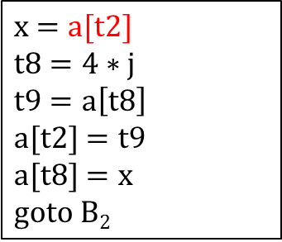
Global Common Subexpressions
$$i= m−1$$
$$j=n$$
$$t1=4∗n$$
$$v=a[t1]$$
$$B1$$
$$if i≥j goto B6$$
$$B4$$
$$x=a[t2]$$
$$t8=4∗j$$
$$t9=a\left[t8\right]$$
$$a[t2]=t9$$
$$a[t8]=x$$
$$gotoB2$$
$$B5$$
$$t11=4∗i$$
$$x=a[t11]$$
$$t13=4∗n$$
$$t14=a[t13]$$
$$a[t11]=t14$$
$$a[t13]=x$$
$$B6$$
$$i=i+1$$
$$t2=4∗i$$
$$t3=a[t2]$$
$$if t3<v goto B2$$
$$B2$$
$$j=j−1$$
$$t4=4∗j$$
$$t5=a[t4]$$
$$if t5>v goto B3$$
$$B3$$

Slide 15
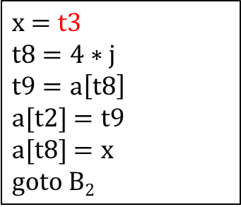
Global Common Subexpressions
$$i= m−1$$
$$j=n$$
$$t1=4∗n$$
$$v=a[t1]$$
$$B1$$
$$if i≥j goto B6$$
$$B4$$
$$x=t3$$
$$t8=4∗j$$
$$t9=a\left[t8\right]$$
$$a[t2]=t9$$
$$a[t8]=x$$
$$gotoB2$$
$$B5$$
$$t11=4∗i$$
$$x=a[t11]$$
$$t13=4∗n$$
$$t14=a[t13]$$
$$a[t11]=t14$$
$$a[t13]=x$$
$$B6$$
$$i=i+1$$
$$t2=4∗i$$
$$t3=a[t2]$$
$$if t3<v goto B2$$
$$B2$$
$$j=j−1$$
$$t4=4∗j$$
$$t5=a[t4]$$
$$if t5>v goto B3$$
$$B3$$

Slide 16
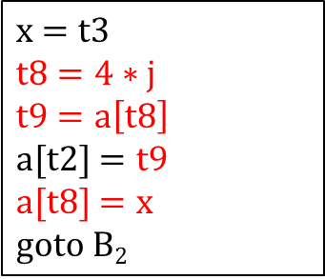

Global Common Subexpressions
$$i= m−1$$
$$j=n$$
$$t1=4∗n$$
$$v=a[t1]$$
$$B1$$
$$if i≥j goto B6$$
$$B4$$
$$x=t3$$
$$t8=4∗j$$
$$t9=a\left[t8\right]$$
$$a[t2]=t9$$
$$a[t8]=x$$
$$gotoB2$$
$$B5$$
$$t11=4∗i$$
$$x=a[t11]$$
$$t13=4∗n$$
$$t14=a[t13]$$
$$a[t11]=t14$$
$$a[t13]=x$$
$$B6$$
$$i=i+1$$
$$t2=4∗i$$
$$t3=a[t2]$$
$$if t3<v goto B2$$
$$B2$$
$$j=j−1$$
$$t4=4∗j$$
$$t5=a[t4]$$
$$if t5>v goto B3$$
$$B3$$

Slide 17
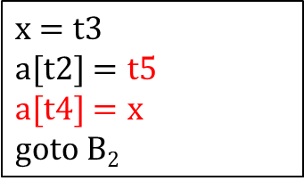
Global Common Subexpressions
$$i= m−1$$
$$j=n$$
$$t1=4∗n$$
$$v=a[t1]$$
$$B1$$
$$if i≥j goto B6$$
$$B4$$
$$x=t3$$
$$a[t2]=t5$$
$$a[t4]=x$$
$$gotoB2$$
$$B5$$
$$t11=4∗i$$
$$x=a[t11]$$
$$t13=4∗n$$
$$t14=a[t13]$$
$$a[t11]=t14$$
$$a[t13]=x$$
$$B6$$
$$i=i+1$$
$$t2=4∗i$$
$$t3=a[t2]$$
$$if t3<v goto B2$$
$$B2$$
$$j=j−1$$
$$t4=4∗j$$
$$t5=a[t4]$$
$$if t5>v goto B3$$
$$B3$$

Slide 18
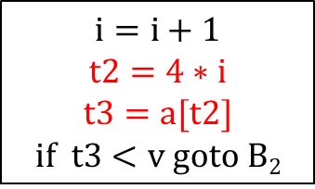
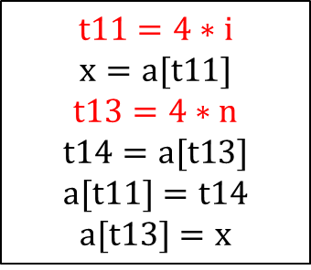
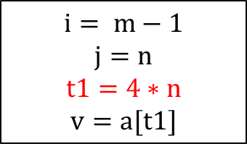
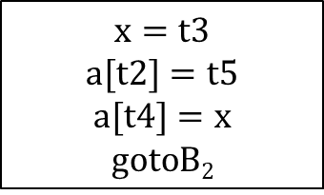
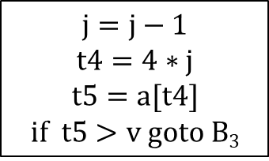
Global Common Subexpressions
$$i= m−1$$
$$j=n$$
$$t1=4∗n$$
$$v=a[t1]$$
$$B1$$
$$if i≥j goto B6$$
$$B4$$
$$x=t3$$
$$a[t2]=t5$$
$$a[t4]=x$$
$$gotoB2$$
$$B5$$
$$t11=4∗i$$
$$x=a[t11]$$
$$t13=4∗n$$
$$t14=a[t13]$$
$$a[t11]=t14$$
$$a[t13]=x$$
$$B6$$
$$i=i+1$$
$$t2=4∗i$$
$$t3=a[t2]$$
$$if t3<v goto B2$$
$$B2$$
$$j=j−1$$
$$t4=4∗j$$
$$t5=a[t4]$$
$$if t5>v goto B3$$
$$B3$$

Slide 19
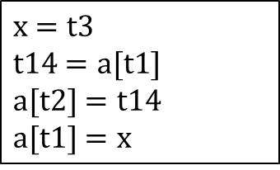
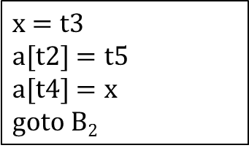
Global Common Subexpressions
$$i= m−1$$
$$j=n$$
$$t1=4∗n$$
$$v=a[t1]$$
$$B1$$
$$if i≥j goto B6$$
$$B4$$
$$x=t3$$
$$a[t2]=t5$$
$$a[t4]=x$$
$$gotoB2$$
$$B5$$
$$x=t3$$
$$t14=a[t1]$$
$$a[t2]=t14$$
$$a[t1]=x$$
$$B6$$
$$i=i+1$$
$$t2=4∗i$$
$$t3=a[t2]$$
$$if t3<v goto B2$$
$$B2$$
$$j=j−1$$
$$t4=4∗j$$
$$t5=a[t4]$$
$$if t5>v goto B3$$
$$B3$$

Slide 20
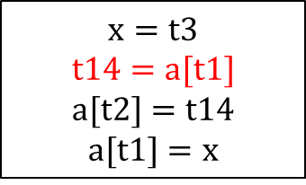
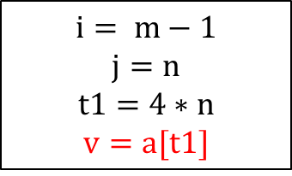
Global Common Subexpressions
$$i= m−1$$
$$j=n$$
$$t1=4∗n$$
$$v=a[t1]$$
$$B1$$
$$if i≥j goto B6$$
$$B4$$
Can v be substituted for a[t1]?
$$x=t3$$
$$a[t2]=t5$$
$$a[t4]=x$$
$$gotoB2$$
$$B5$$
$$x=t3$$
$$t14=a[t1]$$
$$a[t2]=t14$$
$$a[t1]=x$$
$$B6$$
$$i=i+1$$
$$t2=4∗i$$
$$t3=a[t2]$$
$$if t3<v goto B2$$
$$B2$$
$$j=j−1$$
$$t4=4∗j$$
$$t5=a[t4]$$
$$if t5>v goto B3$$
$$B3$$

Slide 21
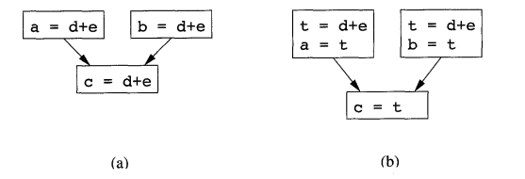
Copy Propagation
Copies are introduced during common subexpression elimination
The idea behind copy-propagation transformation is to use t for c whenever possible after the copy statement c=t

Slide 22
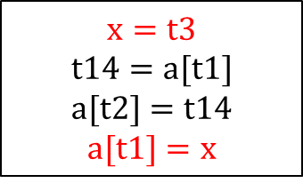
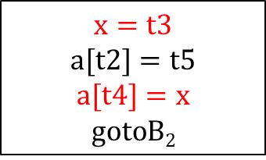
Copy Propagation
$$i= m−1$$
$$j=n$$
$$t1=4∗n$$
$$v=a[t1]$$
$$B1$$
$$if i≥j goto B6$$
$$B4$$
$$x=t3$$
$$a[t2]=t5$$
$$a[t4]=x$$
$$gotoB2$$
$$B5$$
$$x=t3$$
$$t14=a[t1]$$
$$a[t2]=t14$$
$$a[t1]=x$$
$$B6$$
$$i=i+1$$
$$t2=4∗i$$
$$t3=a[t2]$$
$$if t3<v goto B2$$
$$B2$$
$$j=j−1$$
$$t4=4∗j$$
$$t5=a[t4]$$
$$if t5>v goto B3$$
$$B3$$

Slide 23
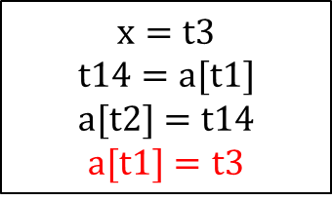
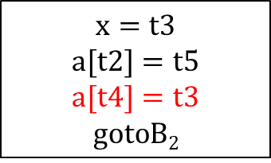
Copy Propagation
$$i= m−1$$
$$j=n$$
$$t1=4∗n$$
$$v=a[t1]$$
$$B1$$
$$if i≥j goto B6$$
$$B4$$
$$x=t3$$
$$a[t2]=t5$$
$$a[t4]=t3$$
$$gotoB2$$
$$B5$$
$$x=t3$$
$$t14=a[t1]$$
$$a[t2]=t14$$
$$a[t1]=t3$$
$$B6$$
$$i=i+1$$
$$t2=4∗i$$
$$t3=a[t2]$$
$$if t3<v goto B2$$
$$B2$$
$$j=j−1$$
$$t4=4∗j$$
$$t5=a[t4]$$
$$if t5>v goto B3$$
$$B3$$

Slide 24
Dead Code Elimination
Dead Code: Statements that computes values that never get used
May result from various transformations, such as-
Constant folding: deducing at compile time that the value of an expression is a constant and using the constant instead
Copy propagation
Example:
constant folding
replaces debug with false
debug = false
… … …
if(debug) print…;
… … …
debug = false
… … …
if(false) print…;
… … …
debug = false
… … …
if(false) print…;
… … …

Slide 25
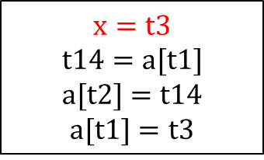
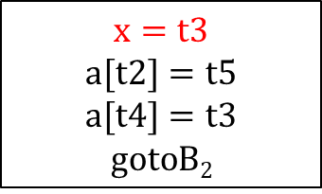
Dead Code Elimination
$$i= m−1$$
$$j=n$$
$$t1=4∗n$$
$$v=a[t1]$$
$$B1$$
$$if i≥j goto B6$$
$$B4$$
$$x=t3$$
$$a[t2]=t5$$
$$a[t4]=t3$$
$$gotoB2$$
$$B5$$
$$x=t3$$
$$t14=a[t1]$$
$$a[t2]=t14$$
$$a[t1]=t3$$
$$B6$$
$$i=i+1$$
$$t2=4∗i$$
$$t3=a[t2]$$
$$if t3<v goto B2$$
$$B2$$
$$j=j−1$$
$$t4=4∗j$$
$$t5=a[t4]$$
$$if t5>v goto B3$$
$$B3$$

Slide 26
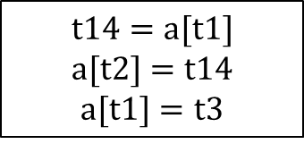
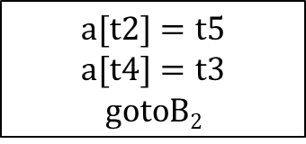
Dead Code Elimination
$$i= m−1$$
$$j=n$$
$$t1=4∗n$$
$$v=a[t1]$$
$$B1$$
$$if i≥j goto B6$$
$$B4$$
$$a[t2]=t5$$
$$a[t4]=t3$$
$$gotoB2$$
$$B5$$
$$t14=a[t1]$$
$$a[t2]=t14$$
$$a[t1]=t3$$
$$B6$$
$$i=i+1$$
$$t2=4∗i$$
$$t3=a[t2]$$
$$if t3<v goto B2$$
$$B2$$
$$j=j−1$$
$$t4=4∗j$$
$$t5=a[t4]$$
$$if t5>v goto B3$$
$$B3$$

Slide 27
Code Motion
Reducing the amount of code in a loop may improve running time of a program significantly
Specially inner loops
Code Motion
Moves loop-invariant computations out the loop and evaluates before the loop.
Example:

Slide 28
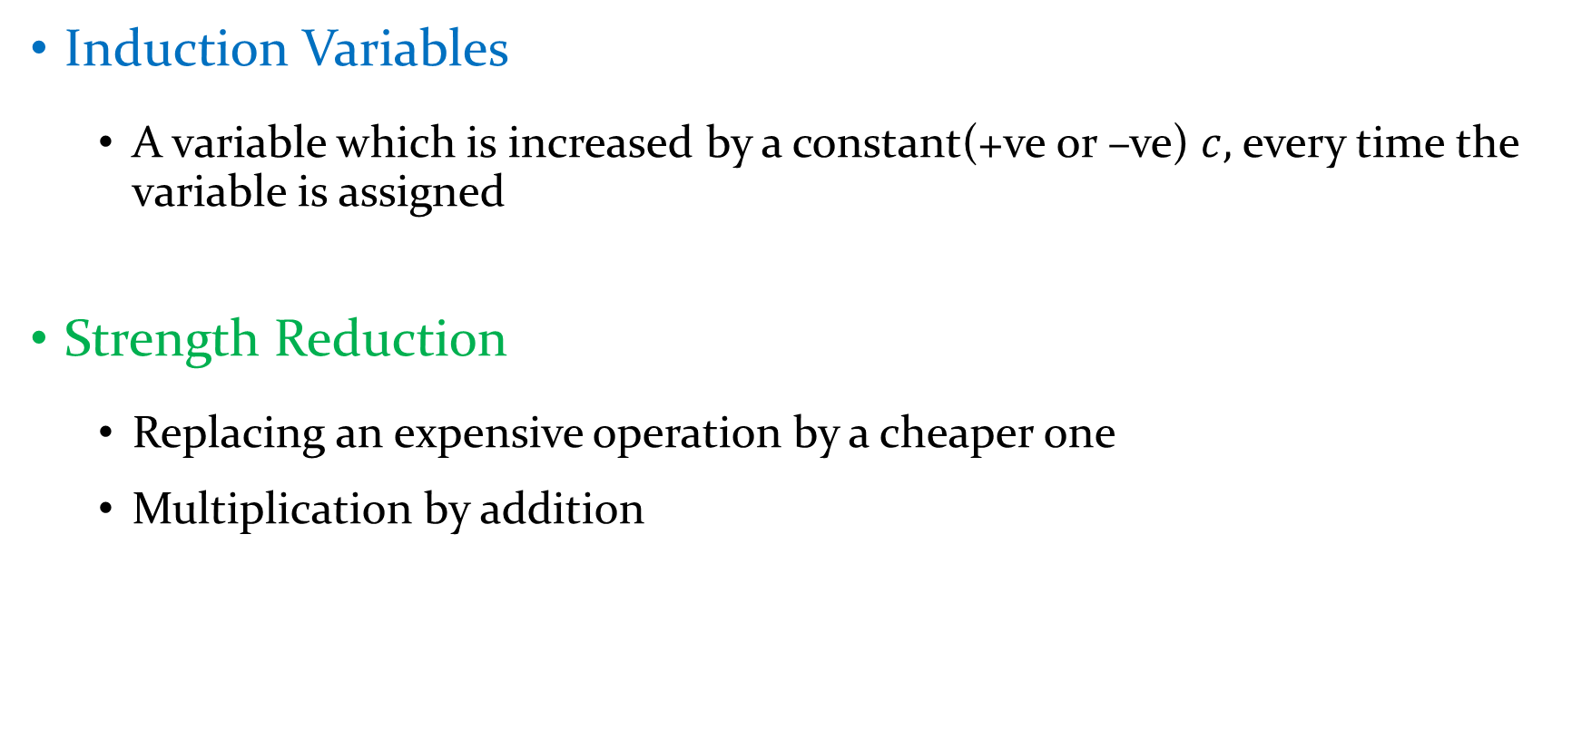
Induction Variables & Strength Reduction
Induction Variables
A variable which is increased by a constant(+ve or –ve) $c,$ every time the variable is assigned
Strength Reduction
Replacing an expensive operation by a cheaper one
Multiplication by addition

Slide 29
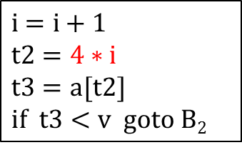
Induction Variables & Strength Reduction
$$i= m−1$$
$$j=n$$
$$t1=4∗n$$
$$v=a[t1]$$
$$B1$$
$$if i≥j goto B6$$
$$B4$$
$$a[t2]=t5$$
$$a[t4]=t3$$
$$gotoB2$$
$$B5$$
$$t14=a[t1]$$
$$a[t2]=t14$$
$$a[t1]=t3$$
$$B6$$
$$i=i+1$$
$$t2=4∗i$$
$$t3=a[t2]$$
$$if t3<v goto B2$$
$$B2$$
$$j=j−1$$
$$t4=4∗j$$
$$t5=a[t4]$$
$$if t5>v goto B3$$
$$B3$$

Slide 30
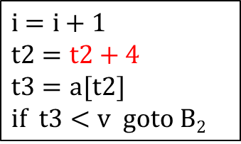
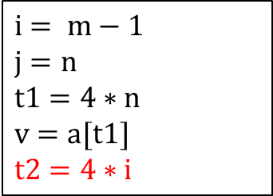
Induction Variables & Strength Reduction
$$i= m−1$$
$$j=n$$
$$t1=4∗n$$
$$v=a[t1]$$
$$t2=4∗i$$
$$B1$$
$$if i≥j goto B6$$
$$B4$$
$$a[t2]=t5$$
$$a[t4]=t3$$
$$gotoB2$$
$$B5$$
$$t14=a[t1]$$
$$a[t2]=t14$$
$$a[t1]=t3$$
$$B6$$
$$i=i+1$$
$$t2=t2+4$$
$$t3=a[t2]$$
$$if t3<v goto B2$$
$$B2$$
$$j=j−1$$
$$t4=4∗j$$
$$t5=a[t4]$$
$$if t5>v goto B3$$
$$B3$$

Slide 31
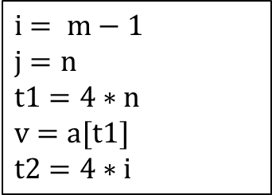
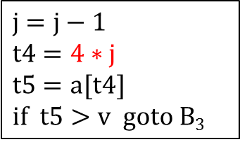
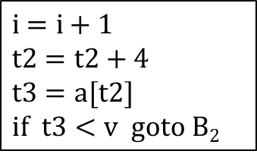
Induction Variables & Strength Reduction
$$i= m−1$$
$$j=n$$
$$t1=4∗n$$
$$v=a[t1]$$
$$t2=4∗i$$
$$B1$$
$$if i≥j goto B6$$
$$B4$$
$$a[t2]=t5$$
$$a[t4]=t3$$
$$gotoB2$$
$$B5$$
$$t14=a[t1]$$
$$a[t2]=t14$$
$$a[t1]=t3$$
$$B6$$
$$i=i+1$$
$$t2=t2+4$$
$$t3=a[t2]$$
$$if t3<v goto B2$$
$$B2$$
$$j=j−1$$
$$t4=4∗j$$
$$t5=a[t4]$$
$$if t5>v goto B3$$
$$B3$$

Slide 32
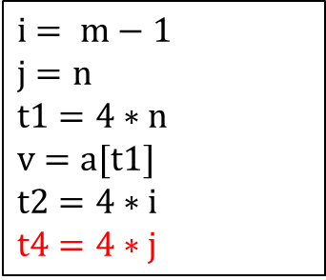
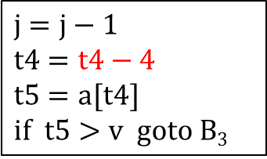
Induction Variables & Strength Reduction
$$i= m−1$$
$$j=n$$
$$t1=4∗n$$
$$v=a[t1]$$
$$t2=4∗i$$
$$t4=4∗j$$
$$B1$$
$$if i≥j goto B6$$
$$B4$$
$$a[t2]=t5$$
$$a[t4]=t3$$
$$gotoB2$$
$$B5$$
$$t14=a[t1]$$
$$a[t2]=t14$$
$$a[t1]=t3$$
$$B6$$
$$i=i+1$$
$$t2=t2+4$$
$$t3=a[t2]$$
$$if t3<v goto B2$$
$$B2$$
$$j=j−1$$
$$t4=t4−4$$
$$t5=a[t4]$$
$$if t5>v goto B3$$
$$B3$$

Slide 33
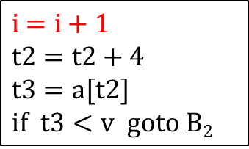



Induction Variables & Strength Reduction
$$i= m−1$$
$$j=n$$
$$t1=4∗n$$
$$v=a[t1]$$
$$t2=4∗i$$
$$t4=4∗j$$
$$B1$$
$$if i≥j goto B6$$
$$B4$$
$$a[t2]=t5$$
$$a[t4]=t3$$
$$gotoB2$$
$$B5$$
$$t14=a[t1]$$
$$a[t2]=t14$$
$$a[t1]=t3$$
$$B6$$
$$i=i+1$$
$$t2=t2+4$$
$$t3=a[t2]$$
$$if t3<v goto B2$$
$$B2$$
$$j=j−1$$
$$t4=t4−4$$
$$t5=a[t4]$$
$$if t5>v goto B3$$
$$B3$$

Slide 34



Induction Variables & Strength Reduction
$$i= m−1$$
$$j=n$$
$$t1=4∗n$$
$$v=a[t1]$$
$$t2=4∗i$$
$$t4=4∗j$$
$$B1$$
$$if t2≥t4 goto B6$$
$$B4$$
$$a[t2]=t5$$
$$a[t4]=t3$$
$$gotoB2$$
$$B5$$
$$t14=a[t1]$$
$$a[t2]=t14$$
$$a[t1]=t3$$
$$B6$$
$$t2=t2+4$$
$$t3=a[t2]$$
$$if t3<v goto B2$$
$$B2$$
$$t4=t4−4$$
$$t5=a[t4]$$
$$if t5>v goto B3$$
$$B3$$

Slide 35


Exercise

Slide 36
Reference
Compilers: Principles, Techniques, & Tools, by
Alfred B. Aho, Monica S. Lam, Ravi Sethi, Jeffrey D. Ullman
Chapter 9
9.1

Slide 37
Thank You!

